Slide 1
Compiler Design
Top-down parsers
Saeed Parsa
Room 332,
School of Computer Engineering,
Iran University of Science & Technology
parsa@iust.ac.ir
Spring 2021

Slide 2
Top-down parsing
Top­ down parsing, starts with the start symbol and apply the productions until arriving at the desired string.
Top-down parsing is called predictive parsing because it predicts what it is going to see.
A predictive parser is characterized by its ability to choose the production to apply solely on the basis of the next input symbol and the current nonterminal being processed.

Slide 3










Top-down parsing – Example
A → a A
| b A
| B a
B → d B | λ
Input String: abda

Slide 4
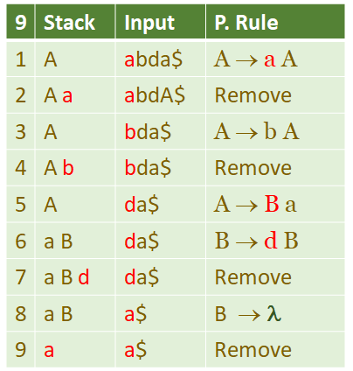
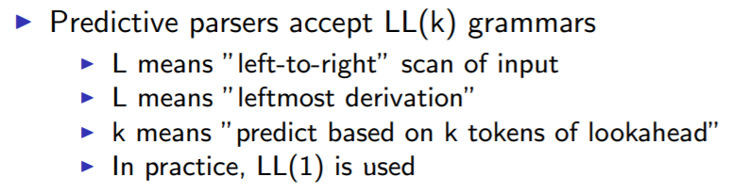
Predictive parsers
A predictive parser uses the next input symbol, as a look-ahead to determine the production rule for expanding the current nonterminal.

Slide 5
LL(1) Grammars
A grammar is LL(1) if it can be parsed by considering only one non-terminal and the next token, as look ahead, in the input stream.
Example: The following grammar is LL(1):
S ::= a S B | d B
B ::= b B | a
Parsing table:
N.T. | a | b | d
S | a S B |  | d B
B | a | bB

Slide 6

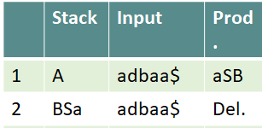








LL(1) Grammars
Example: The following grammar is LL(1):
S ::= a S B | d B
B ::= b B | a
S
Parsing table:
N.T. | a | b | d
S | a S B |  | d B
B | a | bB
Input string: adbaa
Parsing:
Use parsing table
to select a production

Slide 7
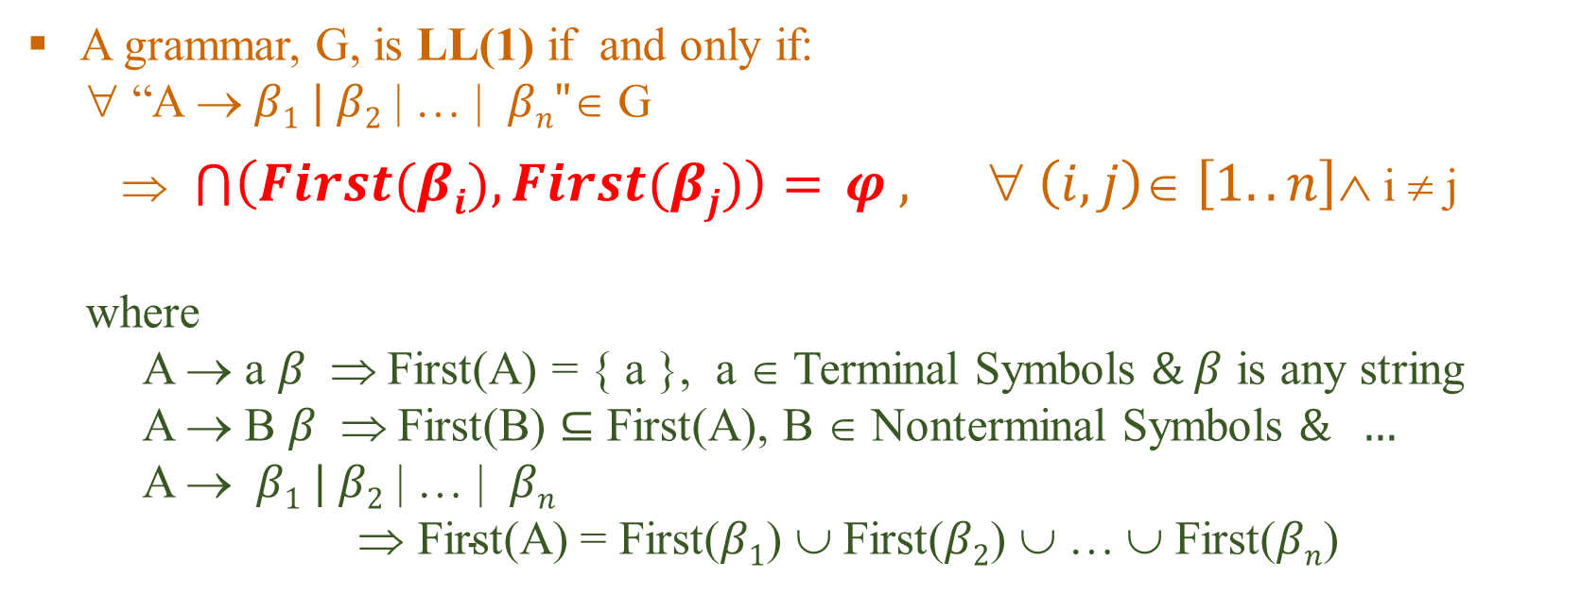
LL(1) Grammars
A grammar, G, is LL(1) if and only if:
∀ “A → $β1 | β2$ | … | $βn"$∈ G
⇒ $\bigcap{\left(First(βi),First(βj)\right)= }φ , ∀ \left(i,j\right)∈ \left[1..n\right]∧$ i ≠ j
where
A → a $β \text{⇒}$ First(A) = { a }, a $$ Terminal Symbols $\& β$ is any string
A → B $β \text{⇒}$ First(B) $⊆$ First(A), B $$ Nonterminal Symbols $\& …$
A → $β1 | β2$ | … | $βn$
$\text{} \text{First}\text{(}\text{A}\text{)}$ = First($β1$) ∪ First($β2$) ∪ … ∪ First($βn$)

Slide 8

First Set: Definition
Suppose A is a non-terminals, First(A) consists of the first terminals that can be derived from A.
if A ⇒* aβ, then a ∈ First(A)
if A ⇒* λ (nullable), then λ ∈ First(A)
E.g.
Another grammar
A → aB | CD
B → Bb | λ
C → c | λ
D → d
First(A) = First(aB)+ First(CD)
= {a} + First(C) + First(D)
= {a, c, d}
First(B) = {b, λ}

Slide 9
First Set: Properties
If X is a terminal or λ, then First(X) = {X}
Suppose X is a nonterminal and X → Y₁Y₂...Y_{k}
if for some i, Y₁...Y_{i-1} ⇒* λ , then First(Y_{i}) – {λ} ⊆ First(X)
if Y₁...Y_{k} ⇒* λ, then λ ∈ First(X)

Slide 10
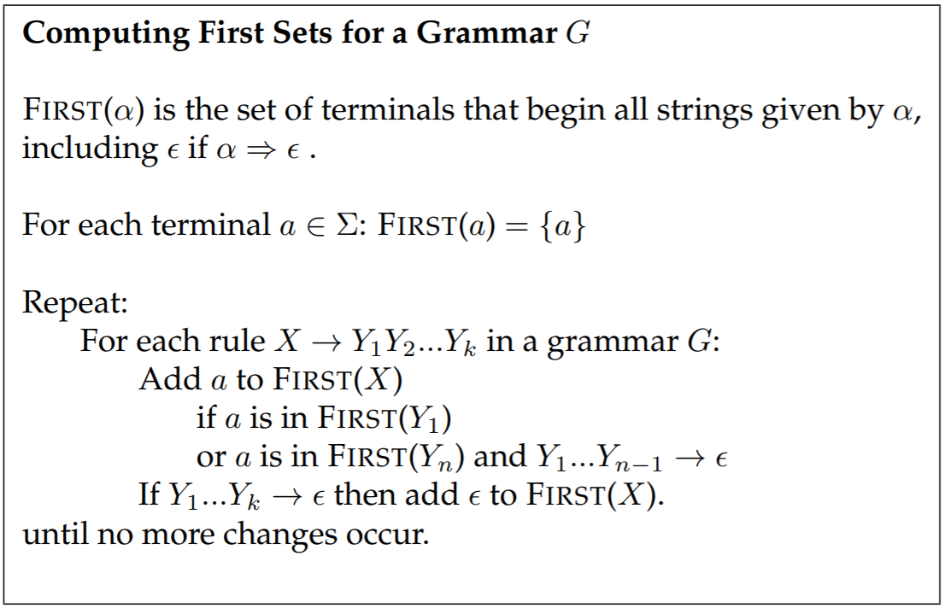
How to compute first sets?

Slide 11
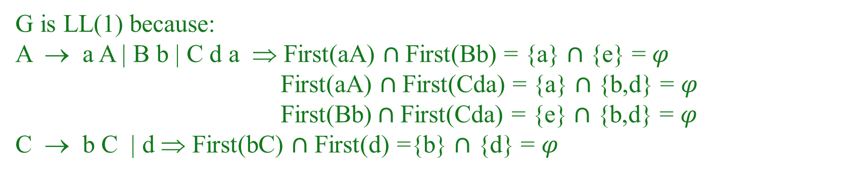
Compute first sets - Example
G: A → a A | B b | C d a
C → b C | d
B → e a
First(B) = First(ea) = {e}
First(C) = First(bC) + First(d) = {b, d}
First(A) = {a} + First(B) + First(C) = {a,b,d,e}
G is LL(1) because:
A → a A | B b | C d a ⇒ First(aA) $∩$First(Bb) = {a} $∩$ {e} = $φ$
First(aA) $∩$First(Cda) = {a} $∩$ {b,d} = $φ$
First(Bb)$∩$First(Cda) = {e} $∩$ {b,d} = $φ$
C → b C | d ⇒ First(bC) $∩$ First(d) ={b} $∩$ {d} = $φ$

Slide 12
Compute first sets - Example
G: A → a A | a B d| C d a
C → d C | a
B → a e
G is not LL(1) because:
A → a A | a B d | C d a ⇒ First(aA) ∩ First(a B b) = {a} ≠ 𝜑
also First(Cda) = {d, a}
⇒ if (look-ahead == {a} ∧ current symbol == A )
then it will not be possible to determine which production to choose

Slide 13
LL(1) Grammars
A grammar is LL(1) if and only if:
No two distinct productions with the same LHS can generate the same first terminal symbol. (eg. A → a α | a β is not LL{1})
No nullable symbol ‘A’ has the same terminal symbol ‘a’ in both its first and follow sets for distinct production rules.
There is only one way to send a nullable symbol to λ.

Slide 14
Follow Set: Definition
What?
The Follow set of a non-terminal, A, is the First of symbols that come after A.
Why?
For a grammar, G, to be LL(1), as described before:
∀ B ∈ G | Nullable(B) ⇒ First(B) ∩ Follow(B) = φ
How?
A → α B β ⇒ Follow(B) = First(β)
if nullable (β) ⇒ Follow(B)= First(β)+Follow(A)

Slide 15
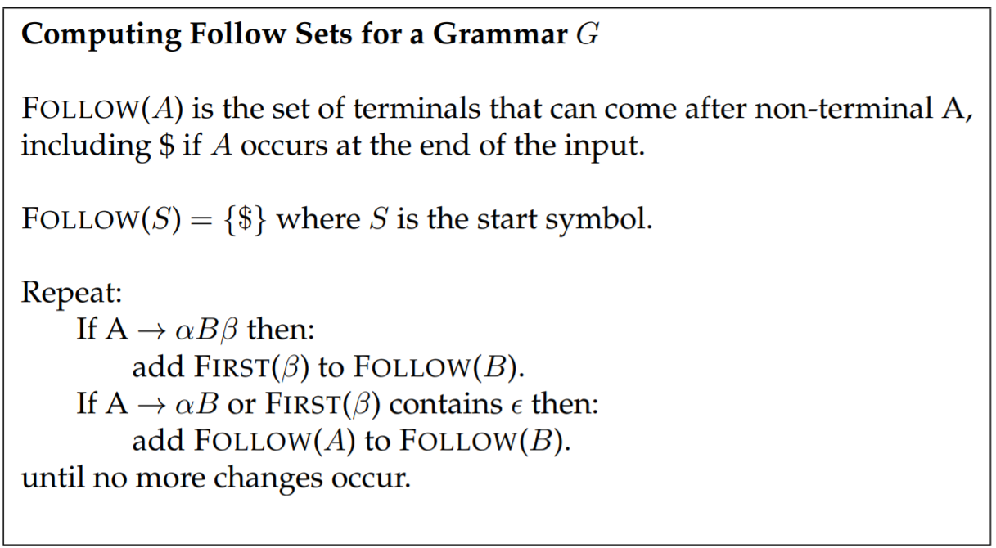
How to compute follow sets?

Slide 16
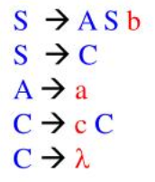
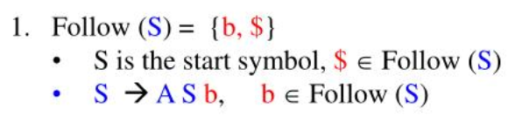
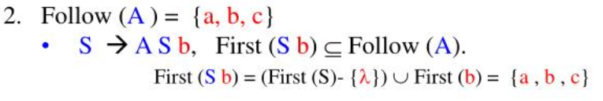
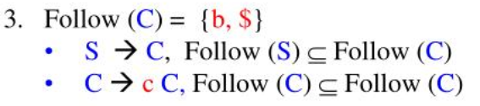
Compute follow sets - Example
Notice:
Always add the end of
File marker, $, to the Follow(start symbol)

Slide 17
Compute follow sets - Example
G: S → L B
L → id : | λ
B → i C t S E
E → e S | λ
1. S is the start symbol then let $ ∈ Follow(S)
B → i C t S E => First(E) ∈ Follow(S) => Follow(S) = {e, $}
S → L B => S → id : B | B => First(S) = {id}∪ First(B) = {id, i}
2. S → L B => Follow(S) ⊆ Follow(B) => Follow(B) = {e, $}
B → i C t S E => First(B) = {i}
3. S → L B => Follow(L) = First(B) = {i}
4. B → i C t S E => Follow(B) ⊆ Follow(E) => Follow(B) = {e, $}

Slide 18
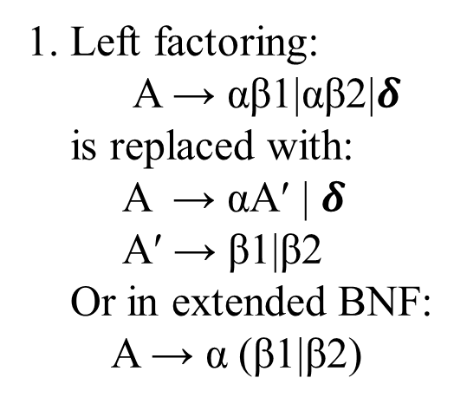
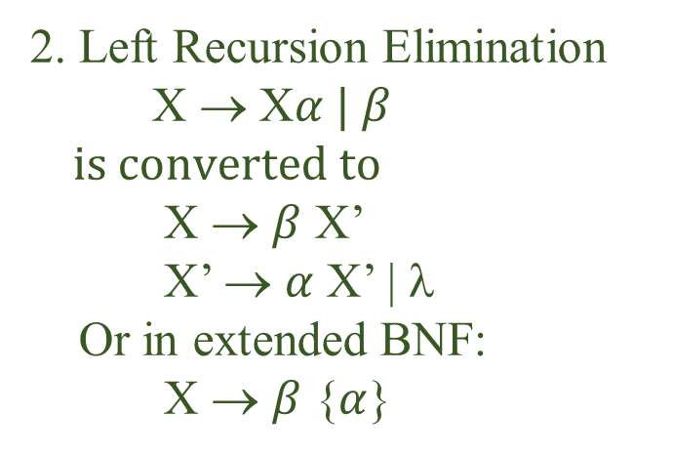
How to transform grammar to LL(1)
To ensure that a grammar is LL(1), we must do the following:
Eliminate any common left prefixes,
Eliminate any left recursion, as shown below.
Eliminate nullable productions, if they cause problem.
1. Left factoring:
A → αβ1|αβ2|$δ$
is replaced with:
A → αA′ | $δ$
A′ → β1|β2
Or in extended BNF:
A → α (β1|β2)
2. Left Recursion Elimination
X → X$α | β$
$$is converted to$$
X → $β$ X’
X’ → $α$ X’ | λ
Or in extended BNF:
X → $β$ {$α$}
3. No nullable symbol A has the same terminal symbol a in both its first and follow sets for distinct production rules.

Slide 19
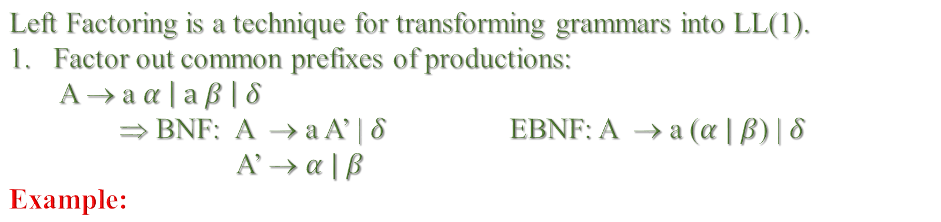
Left Factoring
Left Factoring is a technique for transforming grammars into LL(1).
Factor out common prefixes of productions:
A → a $α \left| a β \right| δ$
⇒ BNF: A → a A’ | $δ$ EBNF: A → a ($α | β$) | $δ$
A’ → $α | β$
Example:
G: A → a e A | a B d | C d a ⇒
C → d C | a
B → a e
A → a e A | a B d | d C d a | a d a
C → d C | a
B → a e
⇒ A → a A’ | d C d a
A’ → e A |B d | d a
C → d C | a
B → a e

Slide 20
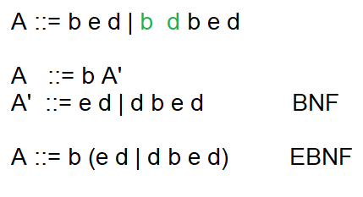
Null productions
We say that a nonterminal x is nullable if the
empty sequence can be derived from it.
X ⇒* λ then Nullable(X) = true
To be LL(1) for any production:
Y → α β δ ∧ α ⇒* λ
First(α) ∩ First(β) should be empty.
A → B b e d
B → b d | λ
First(B) ∩ Follow(B) = {b}

Slide 21
Null productions - Example
Paziraee ::= PishGhaza Ghaza Deser Kotak
PishGaza ::= sup β1| Ash β2| panir β3| salad β4| λ
Ghaza ::= Ash β5 | Abgusht | Pitza | Kabab | λ
Deser ::= Bastani | SholehZard | Miveh | λ
Kotak ::= Chomagh | Shamsir
First(PishGaza) = {sup, Ash, panir, λ} = {sup, Ash, panir}+ Follow(PishGhaza)
Ghaza ::= Ash | Abgusht | Pitza | Kabab | λ
Deser ::= Bastani | SholehZard | Miveh | λ
Kotak ::= Chomagh | Shamsir

Slide 22
Null productions removal
LabeledSt → Label Statement
Label → id : | λ
LabeledSt → id: Statement | Statement
Statement → AssignmentSt | CallSt | IfSt | WhileSt
Statement → id := Expression | id (params) | IfSt | WhileSt
Statement → id CallAssign | IfSt | WhileSt
CallAssign → := Expression | (params)
LabeledSt → id: Statement | id CallAssign | IfSt | WhileSt
LabeledSt → id LaCallAs | IfSt | WhileSt
LaCallAs → : Statement | CallAssign

Slide 23
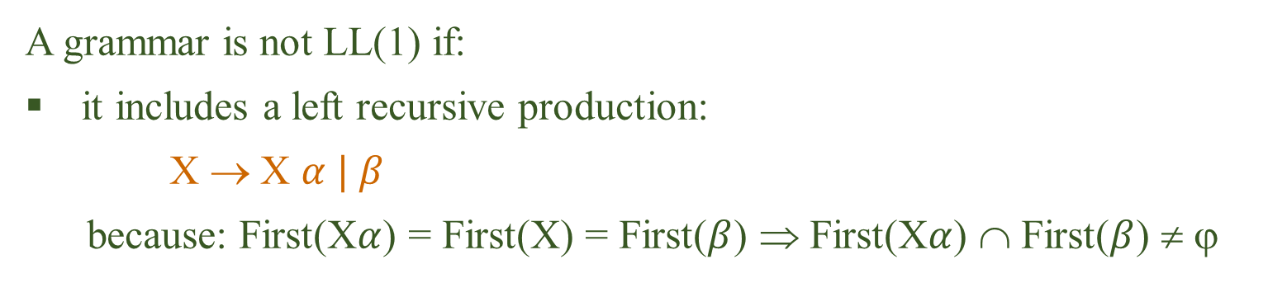
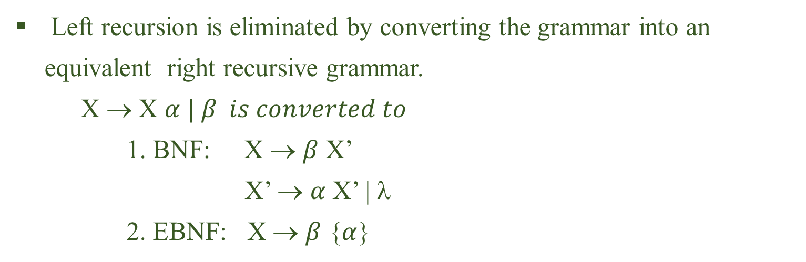
Left Recursion Elimination
A grammar is not LL(1) if:
it includes a left recursive production:
X → X $α | β$
because: First(X$α$) = First(X) = First($β$) ⇒ First(X$α$) ∩ First($β$) ≠ ϕ
Left recursion is eliminated by converting the grammar into an equivalent right recursive grammar.
X → X $α | β is converted to$
1. BNF: X → $β$ X’
X’ → $α$ X’ | λ
2. EBNF: X → $β$ {$α$}

Slide 24
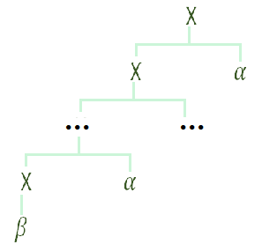
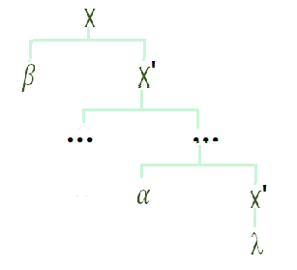
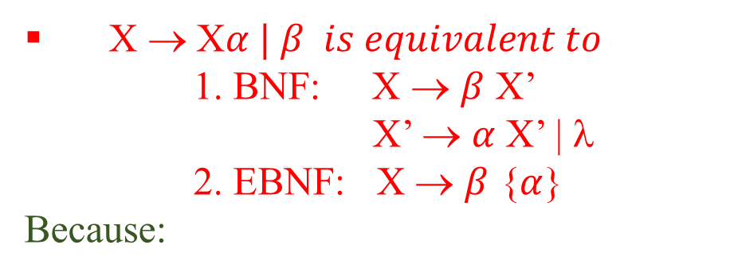


Left Recursion Elimination
X → X$α | β is equivalent to$
1. BNF: X → $β$ X’
X’ → $α$ X’ | λ
2. EBNF: X → $β$ {$α$}
Because:
1. X → X $α | β$
2. X → $β$ {$α$}

Slide 25
Left Recursion Elimination - Example
Consider the regular expressions grammar
E → E + T | E - T | T
T → T * F | T / F | F
F → Id | No | ( E )
1. Left factoring (BNF)
E → E + T | E - T | T ⇒ E → EE” | T
E” → +T | -T
T → T * F | T / F | F ⇒ T → TT” | F
T”→ * F | / F
1. Left factoring (EBNF)
E → E + T | E - T | T
⇒ E → E (+ T | - T) | T
T → T * F | T / F | F
⇒ T → T (* F | / F) | F

Slide 26
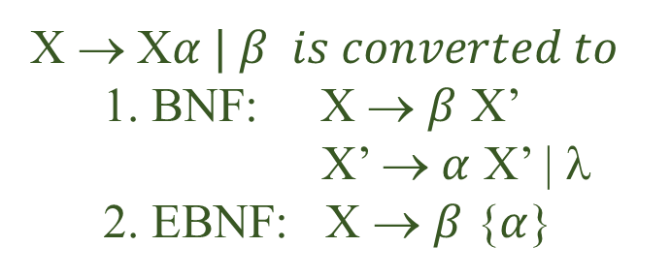
Left Recursion Elimination - Example
2. Left Recursion Elimination (BNF)
E → EE” | T ⇒ E → T E’
E’ → E”E’ | λ
E’ → +T E’ | -T E’ | λ
T → TT” | F⇒ T → F T’
T’→ * F T’| / F T’ | λ
X → X$α | β is converted to$
1. BNF: X → $β$ X’
X’ → $α$ X’ | λ
2. EBNF: X → $β$ {$α$}
2. Left Recursion Elimination (EBNF)
E → E (+ T | - T) | T ⇒ E → T {+ T | - T}
T → T (* F | / F ) | F ⇒ T → F {* F | / F}

Slide 27


Left Recursion Elimination - Example
Consider the regular expressions grammar
E → E + T | E - T | T
T → T * F | T / F | F
F → Id | No | ( E )
- Equivalent G. (BNF)
E → T E’
E’ → +T E’ | -T E’ | λ
T → F T’
T’→ * F T’| / F T’ | λ
F → Id | No | ( E )
- Equivalent G. (EBNF)
E → T {+ T | - T}
T → F {* F | / F}
F → Id | No | ( E )

Slide 28
Parsing Table
The key problem during predictive parsing is that of determining the production to be applied for a non-terminal.
This is done by using a parsing table.
A parsing table is a two-dimensional array M[A,a] where A is a non-terminal, and a is a terminal or the symbol $, menaing “end of input string”.
The other inputs of a predictive parser are:
◦ The input buffer, which contains the string to be parsed followed by $.
◦ The stack which contains a sequence of sentential forms, initially, $S
(end of input string and start symbol) in it.

Slide 29
Example
The purpose of parsing table is to determine which production rule to use next.
Consider the following grammar:
Transform the grammar into LL(1) form,
Use First and follow sets to construct the parsing table,
Use the parsing table to parse given input strings.
G1:
S → d A B | B a B
A → d A | B a
B → b B | λ

Slide 30
Example
1. Convert G1 into the LL(1) form
B → b B | λ
First(B) = {b, λ} => First(B) ∩ Follow(B) should be null.
A → B a => follow(B) = {a}
S → d A B => follow(B) = {a} + {$} = {a, $}
It is assumed that always: $ ∈ follow(Start symbol)
=> $ ∈ follow(S) => $ ∈ follow(dAB) => $ ∈ follow(B)
=> First(B) ∩ Follow(B) = {b} ∩ {a, $} = ϕ
First(B) = {b, λ}, Follow(B) = {a, $}
First(B) = {b, a, $}

Slide 31
Example
A → d A | B a
First(dA) ∩ First(B a) = {d} ∩ {b, a} = ϕ
First(A) = First(dA) ∪ First(B a) ={d, b, a}
S → d A B | B a B
First(dAB) ∩ First(BaB) = {d} ∩ {b , a, $} = ϕ
First(S) = First(dAB) ∪ First(BaB) ∪ First( a )
First(S) = {d} ∪ {b} ∪ {a} = {d, b, a}

Slide 32










Example
 | d | a | b | $
S | dAB | BaB | BaB | BaB
A | dA | Ba | Ba | Ba
B |  | λ | bB | λ
2. Use First sets to work out the parsing table
G1:
S → d A B | B a B
A → d A | B a
B → b B | λ
First(S) = {d, b, a}
First(A) = {d, b, a}
First(B) = {b, λ} = {b, a, $}
Follow(B) = { a, $}

Slide 33
Example
Build parsing table for this grammar:
G2:
S→ ( L ) | a
L→L S | S
1- Eliminate left recursion
G2:
S→ ( L ) | a
L → S L’
L’ → SL’ | λ

Slide 34
Example
Rule | Input | Stack
S→(L) | (a(aa))$ | $ S
 | (a(aa))$ | $ )L(
L→SL’ | a(aa))$ | $ )L
S→a | a(aa))$ | $ ) L’S
Delete | a(aa))$ | $ ) L’a
L’→SL’ | (aa))$ | $ ) L’
S→(L) | (aa))$ | $ ) L’S
Delete | (aa))$ | $ ) L’)L(
L→SL’ | aa))$ | $ ) L’)L
S→a | aa))$ | $ ) L’) L’S
Delete | aa))$ | $ ) L’) L’a
L’→ SL’ | a))$ | $ ) L’) L’
S→a | a))$ | $ ) L’) L’S
Delete | a))$ | $ ) L’) L’a
L’→λ | ))$ | $ ) L’) L’
Delete | ))$ | $ ) L’)
L’→λ | )$ | $ ) L’
Delete | )$ | $ )
 | $ | $
2- Define First set and if required follow sets for the Non-terminals.
First(L’) = First(S) +{λ} ={(, a, λ}
Follow(L’) = Follow(L) = { ) }
First(L) = First(S) = {(, a }
Follow(L)={(,a}+{)} = { (, a, ) }
$ | ) | ( | a
- | - | (L) | a | S
 |  | SL’ | SL’ | L
- | λ | SL’ | SL’ | L’

Slide 35
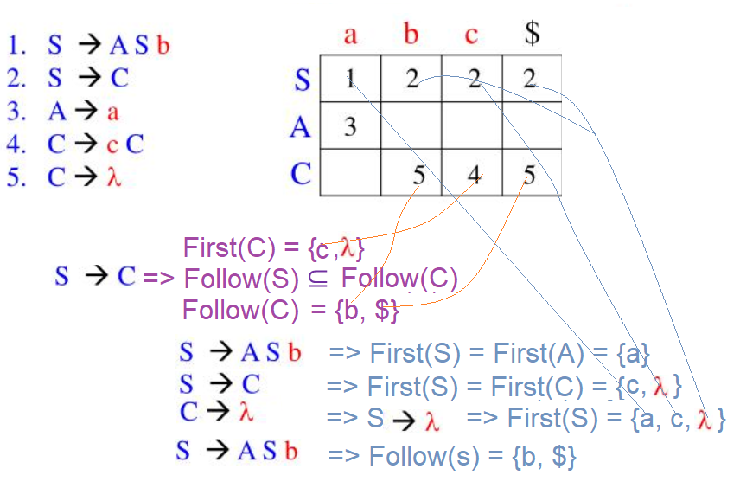
Example

Slide 36

Assignment 4
Subject : Top-down parsers
Deadline: 1399/7/28
Mark: 5 out of 100.

Slide 37

Assignment 4
Exercise 1:
1. Convert this grammar to LL(1)
G1:
S::= ε |A S
A ::= id := id A ::= if id then A A ::= if id then A' else A
A' ::= id := id A' ::= if id then A' else A‘

Slide 38
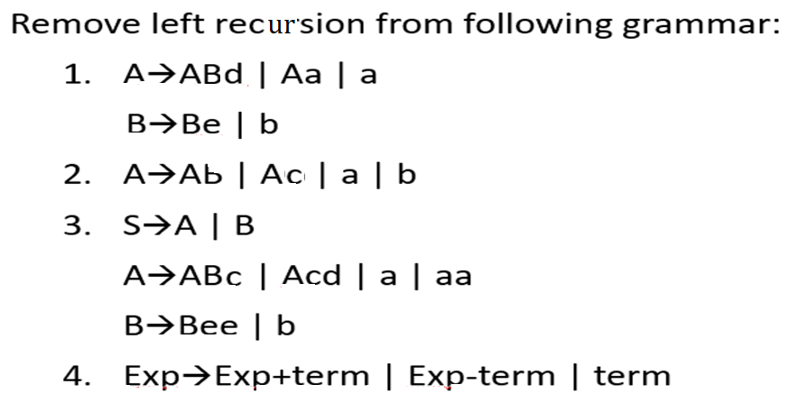
Assignment 4
Exercise 2:

Slide 39
Assignment 4
Answers Ex.2:
1. A ::= ABd | Aa | a
i. Left factoring
A ::= AA” | a
A” ::= Bd | a
ii. Eliminate left recursion
A ::= AA” | a => A ::= aA’
A’ ::= A”A’ | λ
=> A’ ::= Bd A’ | aA’ | λ
B ::= Be | b => B ::= bB’
B’::= e B’ | λ

Slide 40
Assignment 4
Answers Ex.2:
2. A ::= A b |A c| a | b
i. Left factoring
=> A ::= AA” | a | b
A” ::= b | c
ii. Eliminate left recursion
=> A ::= aA’ | b A’
A’ ::= b A’ | c A’ | λ
3. A ::= A B |A c| a | aa
i. Left factoring
=> A ::= AA” | a D
A” ::= B | c
D ::= a | λ
ii. Eliminate left recursion
=> A ::= a D A’
A’ ::= B A’ | c A’ | λ

Slide 41
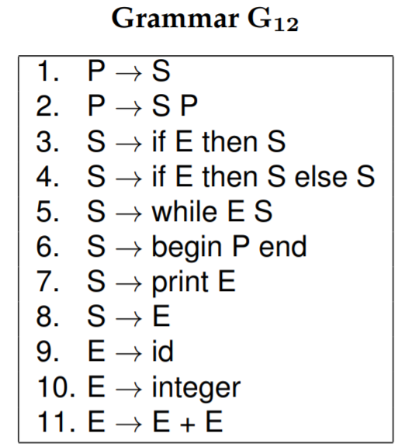
Assignment 4
Exercise 3:
Consider the grammar G12
Point out all aspects of Grammar G12 which are not LL(1).
Write a new grammar which accepts the same language, but avoids left recursion and common left prefixes.
Write the FIRST and FOLLOW sets for the new grammar.
Write out the LL(1) parse table for the new grammar.
Is the new grammar an LL(1) grammar? Explain your answer carefully.

Slide 42
Assignment 4
Exercise 4:
Consider the assignment statements grammar
A → id := E
E → E + T | E - T | T
T → T * F | T / F | F
F → Id | No | ( E )
Convert the grammar to LL(1).
Construct the parsing table for the grammar.
Use the table to parse the statement: a := (b/c*3 – e*f)/2

Slide 43
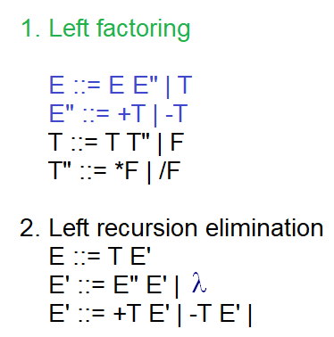
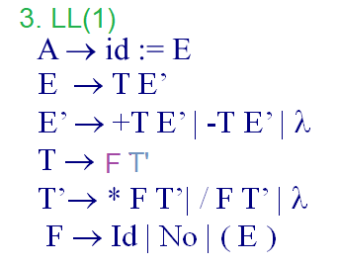
Assignment 4
Answers Ex.4:

Slide 44
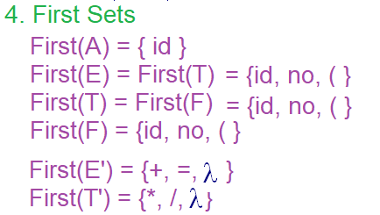
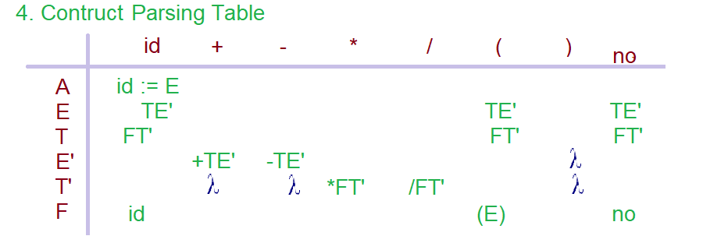
Assignment 4
Answers Ex.4:

Slide 45
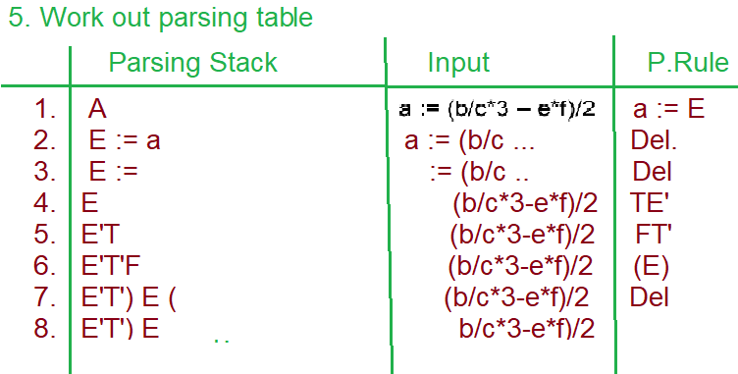
Assignment 4
Answers Ex.4:

Slide 46
Recursive descent parsers
A recursive-descent parser is structured as a set of mutually recursive procedures, one for each nonterminal in the grammar.
The procedure corresponding to nonterminal A recognizes an instance of A in the input stream.
To recognize a nonterminal B on some right-hand side for A, the parser invokes the procedure corresponding to B.
Thus, the grammar itself serves as a guide to the parser's implementation.

Slide 47
Recursive descent parsers
To test for the presence of a nonterminal, say ’A’, the code invokes a procedure, named A.
Suppose: A → a B D
public class Parser {
private enum symbols currentSymbol;
Parser () { currentSymbol = nextSymbol(); A()}
public void A()
{ /*A → */ Expect(‘a’); B(), D(); }
public void Expect(enum Symbols expectedSymbol)
{ if ( currentSymbol == expectedSymbol) currentSymbol = nextSymbol();
else syntaxError(); }

Slide 48
Recursive descent parsers
Recursive descent parsers develop, a procedure / method for each non-terminal A, with the same name as the nonterminal.
For instance:
G: S → if E then S | if E then S else S | begin S L | print E
L → end | ; S L
E → i
There are three non-terminals S, L, and E, in the grammar.
Three methods S(), L() and E() should be written.
A lexical analyzer method nextSymbol() is invoked to get the next lexicon from the input file.
nextSymbol() copies the symbol in a global variable called currentSymbol.
It is assumed that always the next symbol is accessible via currentSymbol, before the next symbol could be analyzed.

Slide 49
Recursive descent parsers
// S → if E then S | if E then S else S | begin S L | print E
public void S()
{ if (currentSymbol == "if")
{ nextSymbol(); E(); expect( "then"); S();
if (currentSymbol == "else") { nextSymbol(); S(); return; }
} else if (currentSymbol == "begin") { nextSymbol(); S(); L(); return; }
else if (currentSymbol == "print")
{ nextSymbol(); E(); return; }
else { throw new IllegalTokenException("Procedure S() expected an 'if’
or 'then' or else or begin or print token " + "but received: "
+ currentSymbol );
}
}
}

Slide 50
Recursive descent parsers
A recursive-descent parser is structured as a set of mutually recursive procedures, one for each nonterminal in the grammar.
For instance consider the regular expressions grammar
G: E → E + T | E - T | T
T → T * F | T / F | F
F → Id | No | ( E )
1. Transform the G into LL(1):
G: E → T E’
E’ → +T E’ | -T E’ | λ
T → TT’
T’→ * F T’| / F T’ | λ
F → Id | No | ( E )
- Equivaled G. (EBNF)
G: E → T {+ T | - T}
T → F {* F | / F}
F → Id | No | ( E )

Slide 51
Recursive descent parsers
The procedure corresponding to nonterminal A recognizes an instance of A in the input stream.
// E → T E’
Public void E()
{ /* E → */ T(); E’(); }
To recognize a nonterminal B on some right-hand side for A, the parser invokes the procedure corresponding to B.
//E’ → +T E’ | -T E’ | λ
Public void E()
{if (currentSymbol == s_Add)
{/* E’ →*/ nextSymbol(); T(); E’();}
else if (currentSymbol == s_Sub)
{/* E’ →*/ nextSymbol(); T(); E’();}
}

Slide 52
Convert EBNF to BNF
For building parsers (especially bottom-up) a BNF grammar is often
better, than EBNF. But it’s easy to convert an EBNF Grammar to BNF:
Convert every repetition { E } to a fresh non-terminal X and add
X ::= | E X.
Convert every option [ E ] to a fresh non-terminal X and add
X ::= | E.
Convert every group ( E ) to a fresh non-terminal X and add
X ::= E.
We can even do away with alternatives by having several productions with the same non-terminal.
X ::= E | E’. becomes X ::= E. X ::= E’.

Slide 53
Recursive descent parsers
For a recursive descent parser it is easier to use extended BNF.
G: E → T {+ T | - T}
T → F {* F | / F}
F → Id | No | ( E )
public class Parser
{ private enum symbols currentSymbol;
Parser() { // Gets the next symbol, as currentSymbol, before calling E
currentSymbol = nextSymbol(); }
// G: E → T {+ T | - T}
public void E( )
{ /* E → */ T();
while ( currentSymbol == S_Add || currentSymbol == S_Sub)
{ nextSymbol(); T(); }
}

Slide 54
Recursive descent parsers
// T → F {* F | / F}
public void T( )
{ /* T→ */ F();
while (currentSymbol == S_Mul || currentSymbol == S_Div)
{ nextSymbol(); F(); } }
// F → Id | No | ( E )
public void F( )
{ if (currentSymbol == S_Id || currentSymbol == S_No) nextSymbol();
else { /* F → ( E ) */
Expect(S_openPar); E(); Expect(S_closePar); }
public void Expect(enum symbols expectedSymbol )
{ if currentSymbol == expectedSymbol) nextSymbol(); else syntaxError(); }
public void nextSymbol( File *input-File){ … }
} //Eof Parser Class.

Slide 55
A Mini Pascal Compiler
Consider the mini-pascal grammar:
ProgramX → Program id ; BlockBody .
Blockbody → [ ConstantDefpart ] [ typeDefPart ] [VarDefPart ]
{FunctionDef | ProcedureDef }CompaundStatement
ConstantDefPart → Const ConstandDef {ConstantDef}
ConstantDef → id = ( No | id ) ;
TypeDefPart → Type TypeDef {TypeDef}
TypeDef → id = (integer | real | character)
VarDefPart → Var VarDef {VarDef}
VarDef → id : (integer | real | character)

Slide 56
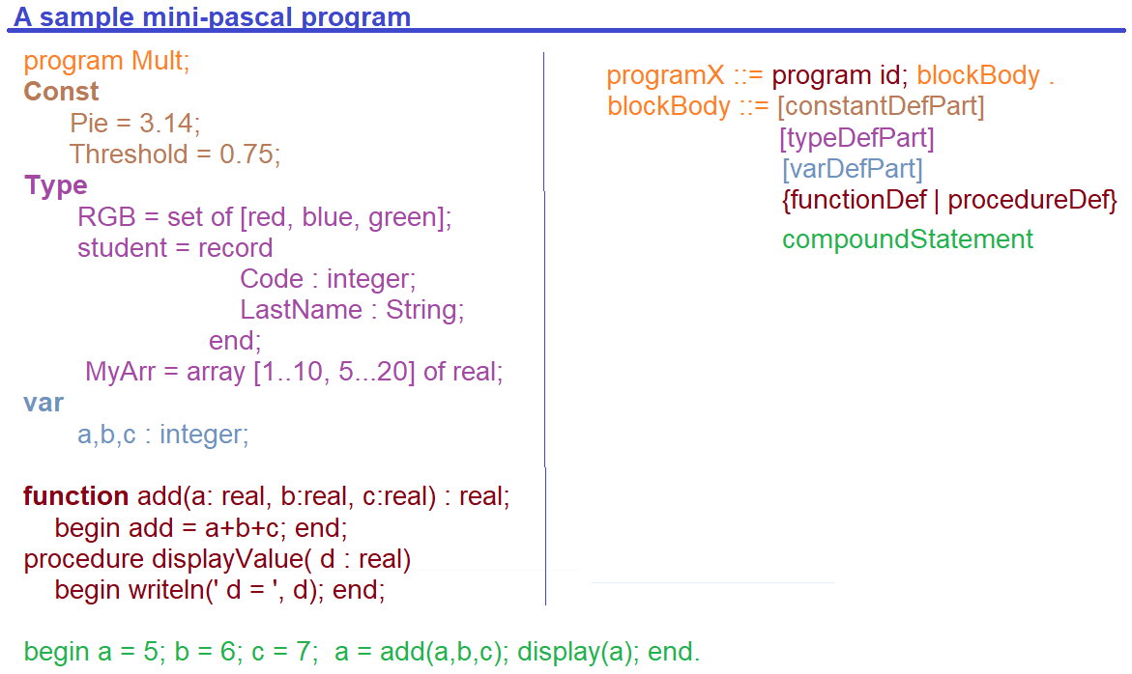
A Mini Pascal Compiler

Slide 57
A Mini Pascal R.D. parser
Begin
init(); // Initializes the Mini-Pascal parser
NextSymbol(); // Get a lookahead
ProgramX(); // Call Starting symbol function
End.
Public class Parser
{ public enum symbols currentSymbol;
Parser(String SourceFile)
{ init(SourceFile); // Open Source and …
NextSymbol(); // currentSymbol = next symbol;
ProgramX(); // Call Start-symbol }
…
}

Slide 58
A Mini Pascal R.D. parser
Recursive descent parsers start by calling the starting symbol of the grammar.
/* ProgramX → Program id ; blockBody . */
public void ProgramX( )
{
Expect( S_Program ); // Expect visiting the “program” keyword
Expect( S_id ); // Expect visiting an identifier
Expect( S_Semi ); // Expect visiting a semicolon
bolckBody( ); // Invoke blockBody()
Expect( S_Dot ); // Expect visiting a dot
}

Slide 59
A Mini Pascal R.D. parser
/* blockBody→ [ constantDefpart ] [ typeDefPart ] [varDefPart ]
{functionDef | procedureDef } compaundStatement */
public void blockBody( )
{ if (currentSymbol == S_Const) constantDefpart;
if (currentSymbol == S_Type) typeDefpart;
if (currentSymbol == S_Var) varDefpart;
while (currentSymbol == S_Procedure || currentSymbol == S_function)
if (currentSymbol == S_Procedure) procedureDef();
else functionDef();
compoundStatement( );
}

Slide 60
A Mini Pascal R.D. parser
/* constantDefpart → Const constandDef {constantDef} */
public void constantDefpart( )
{ Expect( S_Const );
constantDef();
// while currenstSymbol in first(constantDef)
while (currentSymbol == S_Id) constantDef();
}
/* constantDef → id = ( No | id ) ; */
public void constantDefpart( )
{ Expect( S_Id); Expect( S_Eaual);
if(currentSymbol == S_No) nextSymbol()
else Expect( S_Id);
expect(S_Semicolon); }

Slide 61
Error Recovery
Error recovery is Error recovery is a process to act against the error in order to reduce the negative effect of the error.
If the next symbol does not match the expected symbol, then ignore the input symbols as far as next expected symbol is observed.

Slide 62
Error Recovery: Definition
Error recovery is a process to act against the error in order to reduce the negative effect of the error.
Internally the error recovery works as follows:
The location of the syntax error is reported.
If possible, the tokens that would be a legal continuation of the program are reported.
The tokens that can serve to continue parsing are computed. A minimal sequence of tokens is skipped until one of these tokens is found.

Slide 63
Error Recovery
Consider the “Expect” method:
public void Expect( enum Symbols expectedSymbol )
{
if (currentSymbol == expectedSymbol)
nextSymbol( );
else
syntaxError( );
}
We are going to complete the “syntaxError” method:
public void syntaxError( )
{
Console.writeline( “ Syntax Error “);
nextSymbol(); //Get the next look-ahead symbol
}

Slide 64
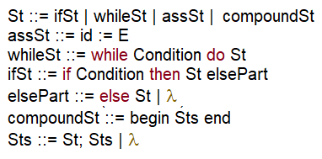
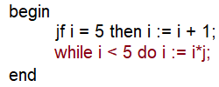
Motivating - Example
Now, consider this grammar:
Consider the following code:

Slide 65
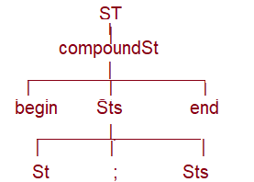
Motivating - Example
/* compoundSt ::= begin Sts end*/
procedure St( )
begin
Expect(S_Begin);
Sts();
Expect(S_end);
end;
Look ahead : begin
/* Sts ::= St; Sts | λ */
procedure Sts( )
begin
St( ); Expect(S_semicolon);
Sts();
end;

Slide 66
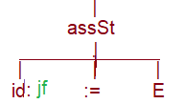
Motivating - Example
/* St ::= ifSt | whileSt | assSt | compounSt */
procedure St( )
begin
if currentSymbol = s_if) then ifSt( )
else if currentSymbol = s_while) then whileSt( )
else if currentSymbol = s_id) then assSt( )
else Expect(s_begin);
end;
Look ahead : begin
Look ahead : jf

Slide 67
Motivating - Example
public void Expect( enum Symbols expectedSymbol )
{
if (currentSymbol == expectedSymbol)
nextSymbol( );
else
syntaxError( );
}
public void Expect( enum Symbols expectedSymbol )
{
Console.writeline( “ Syntax Error “);
nextSymbol(); //Get the next look-ahead symbol
}
/* assSt ::= id := E
procedure assSt( )
begin
nextSymbol( );
Expect(s_assign);
E()
end;
begin
Jf i = 5 then i := i+1;
while j< 5 di i := i*j;
end
Expected: S_id
Look ahead: i

Slide 68
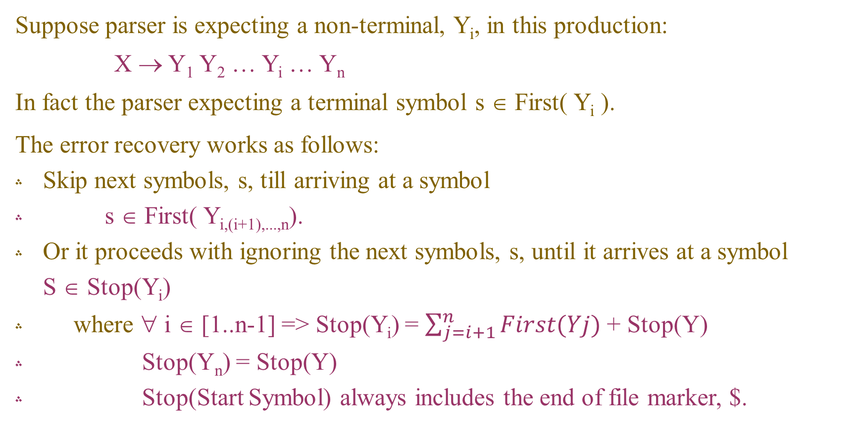
Error Recovery: Approach
Suppose parser is expecting a non-terminal, Y_{i}, in this production:
X → Y₁ Y₂ … Y_{i} … Y_{n}
In fact the parser expecting a terminal symbol s ∈ First( Y_{i} ).
The error recovery works as follows:
Skip next symbols, s, till arriving at a symbol
s ∈ First( Y_{i,(i+1),...,n}).
Or it proceeds with ignoring the next symbols, s, until it arrives at a symbol S ∈ Stop(Y_{i})
where ∀ i ∈ [1..n-1] => Stop(Y_{i}) = $\sum_{j=i+1}^{n}{First(Yj)}$ + Stop(Y)
Stop(Y_{n}) = Stop(Y)
Stop(Start Symbol) always includes the end of file marker, $.

Slide 69
Stop sets
G1:
St → ifSt | whileSt | assSt | compoundSt
=> Stop(St) = [s_eof] since St is the start symbol,
=> Stop(ifSt) = Stop(whileSt) = Stop(assSt) = Stop(compoundSt) = Stop(St) = [s_eof]
compoundSt → begin Sts end
=> Stop(s_begin) = First(Sts) + [s_end] + Stop[compoundSt]= [s_end, s_eof]
=> Stop(Sts) = [s_end] + Stop[compoundSt] = [s_eof, s_end]
=> Stop(s_end) = Stop[compoundSt] = [s_eof]
Sts → St ; Sts | St
=> Stop(St) = [s_semicolon] + first(St) + Stop(Sts)
= [s_semicolon] + First(ifSt) + First(whileSt) + First(assSt) +
First(compoundSt) + [s_eof, s_end];

Slide 70
Error recovery with stop sets
The “Expect” method is modified as follows:
public void Expect( enum Symbols expectedSymbol , HashSet Stop)
{
if (currentSymbol == expectedSymbol)
nextSymbol( );
else syntaxError( Stop );
}
We are going to complete the “syntaxError” method:
public void syntaxError( HashSet<enum symbols> Stop )
{
Console.writeline( “ Syntax Error “);
while( !Stop.contains( currentSymbol ) )
nextSymbol();
}

Slide 71
Error recovery with stop sets
The Expect method is modified as follows:
(* Expect compares expected symbol S with the current symbol *)
Procedure Expect ( ExpectedSymbol : Symbols , Stop : Set of Symbols ) ;
Begin
if Currentsymbol = ExpectedSymbol Then Nextsymbol
Else SyntaxError( Stop ) ;
End {Expect};
Procedure SyntaxError(Stop: Set of Symbols);
Begin
promptMsg(‘ Syntax error at‘, LineNo, ColNo) ;
While not (CurrentSymbol in Stop) DO NextSymbol() ;
End{ SyntaxError };

Slide 72
Error recovery with stop sets
The main body of the Mini-pascal compiler is modified as follows:
Program MiniPascalComplier;
Type
Symbols = ( S_if , S_while, S_repeat , S_for, S_Case, S_then, S_else, S_do,
S_program, S_uses, S_interface, S_unit, S_begin, S_end,
S_label, S_const, S_type, S_var, S_procedure, S_function,
S_integer , S_real , S_char, S_array, S_record, S_pointer,
S_lt , S_gt , S_eq , S_le , S_ge, S_ne, S_add, S_sub, S_or, S_mul,
S_div, S_and, S_id, S_no, S_not, S_comma, S_colon, S_semicolon,
S_dot, S_OpBracket, S_ClBracket, S_OpCurlyB, S_ClCurlyB,
S_OpSquB, S_ClSquB );
Var CurrentSymbol: Symbols;

Slide 73
Example 1
Convert this grammar into LL(1) form and write a recursive-descent parser for it:
G1:
S → aB | aC | dD
D → Da | Db | d
B → BC | b
C → Cd | d
G1:
S → a (B | C) | dD
D → d { a | b }
B → b { C }
C → d {d}
First(S) = {a, d}
First(D) = {d}
First(B) = {b}
First(C) = {d}

Slide 74
Example 1
Begin
init();
NextSymbol();
S(S_EOF);
End.
(* S → a (B | C ) | dD *)
Procedure S( Stop : Set of Symbols);
Begin
If(CurrentSymbol = S_d) Then Begin NextSymbol; D( Stop ); End
Else Expect(S_a, [S_b, S_d] + Stop);
End;

Slide 75
Example 1
(* D → d { a | b } *)
Procedure D( Stop : Set of Symbols);
Begin
Expect(S_d, [S_b, S_d] + Stop);
While(CurrentSymbol = S_a ) Or (CurrentSymbol = S_b) do
If CurrentSymbol = S_a Then NextSymbol
Else Expect(S_a, [S_b, S_d] + Stop);
End;
(*B → b { d }*)
Procedure B( Stop : Set of Symbols);
Begin
Expect(S_b, [ S_d] + Stop);
While(CurrentSymbol = S_d ) do NextSymbol;
End;
(*C → d { d }*)
Procedure C( Stop : Set of Symbols)
Begin
Expect(S_d, [ S_d] + Stop);
While(CurrentSymbol = S_d ) do NextSymbol;
End;

Slide 76
Example 2
Convert this grammar into LL(1) and write a recursive-descent parser for it:
G2:
S → Aa | Bd | Sc
A → Aa | λ
B → Bb | λ
A → {a} A is nullable
B → {b} B is nullable
First(A) = {a, λ}
Follow(A) = {a}
First(A) ∩ Follow(A) = {a} ≠ ϕ
S → {a}a | Bd | Sc
S → {a{a}| Bd }c
First(B) = {b, λ}
Follow(B) = {d}
First(B) ∩ Follow(B) = ϕ
First(S) = {a, b, c, d}

Slide 77
Example 2
G2:
S → Aa | Bd | Sc
A → Aa | λ
B → Bb | λ
G2:
S → { a{a} | b{b} | d } c
/* S → { a{a} | b{b} | d } c */
public void S(HashSet Stop)
{ HashSet<char> Follow = new HashSet<char>();
if (currentSymbol == ‘a’)
while (currentSymbol == ‘a’) nextSymbol();
else if (currentSymbol == ‘b’)
while (currentSymbol == ‘b’) nextSymbol();
else
{ Follow.Add (‘a’); Follow.sAdd (‘b’);
Follow.Add (‘c’); Follows.Add (‘d’);
Expect(‘d’, Follow+ Stop); }
Expect(d, Stop),

Slide 78
Example 3
Convert this grammar into LL(1) and write a recursive-descent parser for it:
G3:
Expression → SimpleExp {RelOp SimpleExp}
RelOp → < | <= | = | <> | >= | > | IN
SimpleExp → Term { ( ‘+’ | ‘-’ | Or ) Term }
Term → Factor { (‘/’ | ‘*’ | DIV | AND) Factor}
Factor → Number | NOT Factor | ‘(‘ Expression ‘)’ | Variable
Variable → Identifier { ‘[‘ Dim ‘]’ }
Dim → Expression { ‘ ,’ Expression }

Slide 79
Example 3
Expression → SimpleExp {RelOp SimpleExp} => First(Expression) = First(SimpleExp)
RelOp → < | <= | = | <> | >= | > | IN => First(Relop) = [<,<=.=,<>,>=,>, IN]
SimpleExp → Term { ( ‘+’ | ‘-’ | Or ) Term } => First(SimpleExp) = First(Term)
Term → Factor { (‘/’ | ‘*’ | DIV | AND) Factor} => First(Term) = First(Factor)
Factor → Number | NOT Factor | => First(Factor) = [ Number, Not,
‘(‘ Expression ‘)’ ‘(‘ ]
| Variable + First(Variable)
Variable → Identifier { ‘[‘ Dim ‘]’ } => First(Variable) = [Identifier]
Dim → Expression { ‘ ,’ Expression } => First(Dim) = First(Expression)
First(Expression) = First(SimpleExp} = First(Term) = First(Factor) =
[Number, Not, ‘(‘, Identifier]

Slide 80
Example 3
Begin
Init( );
NextSymbol([S_Eof]);
Expression( );
End.
(*Expression →SimpleExp { RelOp SimpleExp } *)
procedure Expression(Stop: Set of Symbols);
Begin
FirstSetOfRelop = [ < , <=, = , < > , >= | > | IN ];
FirstSimpleExp = [Number, Not, ‘(‘, Identifier ];
SimpleExp( Stop + FirstSetOfRelop );
while CurrentSymbol in FirstSetOfRelop do
Begin
RelOp(Stop + FirstSimpleExp); SimpleExp (Stop + FirstSetOfRelop);
End;
End {Expression};

Slide 81
Example 4
Convert this grammar into LL(1) form and write a recursive-descent parser for it:
G4:
S → L D
L → id : | λ
D → A | C | I | B
A → id := no + id
C → id ( )
B → begin T end
T → T; S | S
I → if (id > no) goto id

Slide 82
Example 4
S → L D => First(S) = First(L)
L → id : | λ => First(L) = [id, λ] nullable
S → L D => Follow(L) = First(D)
D → A | C | I | B => First(D) = [id, if, begin]
=> First(C) ∩ First(D) = [id] ≠ ϕ Not LL(1)
=> First(L) ∩ Follow (L) = [id] ≠ ϕ Not LL(1)
=> D → id := no + id | id ( ) | I | B
Left refactoring : D → id G | I | B
G → := no + id | ( )
Null production Elimination:
S → id: D | id G | I | B
Left Factoring: S → id (: D | G) | I | B

Slide 83
Example 4
G4:
S → id (: D |G }| I | B => First(S) = [id, if, begin]
D → id G | I | B => First(D) = [id, if, begin]
G → := no | ( ) => First(G) = [no, ( ]
B → begin T end => First(B) = [Begin]
T → S{; S } => First(G) = [id, if, begin]
I → if (id > no) goto id => First(I) = [if]

Slide 84
Example 5
Convert this grammar to LL(1) in BNF and construct parsing table. Show the parsing steps for the given input string:
G1:
S ::= L |A S
L ::= γ |A
A ::= id := id + no A ::= if id then A A ::= if id then A else A
Input: if I then if j then a := a + 12

Slide 85
Example 5
First, we show that G1 is not LL(1).
For production rule S ::= L |A S :
First(L) = {λ} + First(A) = {‘id’, ‘if’, λ}
First(AS) = First(A) = {‘id’, ‘if’}
First(L) ∩ First(AS) ≠ φ
So, G1 is not LL(1).
G1:
S ::= L |A S
L ::= γ |A
A ::=
id := id + no | if id then A |
if id then A else A

Slide 86
Example 5
Now, we want to transform G1 to LL(1):
Step 1:
Remove production L ::= γ |A because of resolve S ::= L |AS
S ::= A | AS | λ
Step 2:
Left-refactoring:
S ::= AB | λ
B ::= S
So we can write just:
S ::= AS | λ
G1:
S ::= L |A S
L ::= γ |A
A ::=
id := id + no | if id then A |
if id then A else A

Slide 87
Example 5
Step 3:
Left-refactoring:
A ::= if id then AA’ | id := id + no
A’ ::= else A | λ
So, we have:
S ::= AS | λ
A ::= if id then AA’ | id := id + no
A’ ::= else A | λ
No left Recursion.
G1:
S ::= L |A S
L ::= γ |A
A ::=
id := id + no | if id then A |
if id then A else A

Slide 88
Example 5
S ::= AS | λ
A ::= if id then AA’ | id := id + no
A’ ::= else A | λ
λ-productions:
S → First(S) ∩ Follow(S) = {λ, ‘id’, ‘if’} ∩ {$} = φ
A’ → First(A’) ∩ Follow(A’) = {‘else’, λ} ∩ {‘if’, ‘id’} = φ
So, don’t cause problem & don’t need to remove!
So G1 transformed to LL(1).
G1:
S ::= L |A S
L ::= γ |A
A ::= id := id + no | if id then A |
if id then A else A

Slide 89
Example 5
Now, we can construct the parsing table:
S ::= AS | λ
A ::= if id then AA’ | id := id + no
A’ ::= else A | λ
First(S) = {‘if’, ‘id’, $}
Follow(S) = {$}
First(A) = {‘if’, ‘id’}
First(A’) = {‘else’, ‘if’, ‘id’, $}
Follow(A’) = {‘if’, ‘id’, $}
 | if | id | else | $
S | AS | AS |  | λ
A | if id then AA’ | id := id + no
A’ | λ | λ | else A | λ

Slide 90
Example 5
 | Stack | Input | rule
1. | S | if i then if j then a := a + 12 $ | AS
2. | SA | if i then if j then a := a + 12 $ | if id then AA’
3. | SA’A then id if | if i then if j then a := a + 12 $ | Del.
4. | SA’A then id | i then if j then a := a + 12 $ | Del.
5. | SA’A then | then if j then a := a + 12 $ | Del.
6. | SA’A | if j then a := a + 12 $ | if id then AA’
7. | SA’A then id if | if j then a := a + 12 $ | Del.
8. | SA’A then id | j then a := a + 12 $ | Del.
9. | SA’A then | then a := a + 12 $ | Del.
10. | SA’A | a := a + 12 $ | id := id + no
11. | SA’ no + id := id | a := a + 12 $ | Del.
12. | SA’ no + id := | := a + 12 $ | Del.
13. | SA’ no + id | a + 12 $ | Del.
14. | SA’ no + | + 12 $ | Del.
15. | SA’ no | 12 $ | Del.
16. | SA’ | $ | λ
17. | S | $ | λ
And, we can show the parsing steps of the input:
if i then if j then a := a + 12
G1:
S ::= AS | λ
A ::= if id then AA’ | id := id + no
A’ ::= else A | λ

Slide 91
Example 6
Convert G1 into LL(1) in EBNF and write a recursive descent parser in Python and then run the program.
Input: If I then if j then a := a + 12
Output: parsing steps including the entry and exit from each non-terminal.

Slide 92
Example 6
BNF:
S ::= AS | λ
A ::= if id then AA’ | id := id + no
A’ ::= else A | λ
EBNF:
S ::= [AS]
A ::= if id then A [else A]
| id := id + no

Slide 93
Example 6
The recursive descent parser python code is shown below:
First, we have to define our tokens & save them in the dictionary.
S_id = 0
S_if = 1
S_then = 2
S_no = 3
S_assign = 4
S_plus = 5
S_else = 6
S_EOF = 7
symbol_dict = {
"if" : S_if, "then" : S_then,
"+" : S_plus, 'else' : S_else, ":=" : S_assign
}

Slide 94
Example 6
Now, we have to write a lexer function to tokenize our input & save the tokens in a list.
def Cute_lexer(input_str: str):
tokens = [item for item in input_str.split(' ') if item != '']
results = []
for token in tokens:
token = token.lower()
if(token in symbol_dict):
results.append((token, symbol_dict[token]))
elif token.isdigit():
results.append((token, S_no))
else:
results.append((token, S_id))
results.append(('EOF', S_EOF))
return results

Slide 95
Example 6
Now, we can write a class Parser & define the first sets we need in the constructor.
class Parser:
def __init__(self, symbols):
self.first_A = [S_if, S_id]
self.firts_S = self.first_A
self.first_A_prime = [S_else]
self.symbols = symbols
self.current_symbol = 0 # array index

Slide 96
Example 6
After that, we have to define next_symbol() & expect() function.
Also, we handle error recovery in expect().
def next_symbol(self):
# next array index
self.current_symbol = self.current_symbol + 1
def expect(self, symbol):
if(self.symbols[self.current_symbol][1] == symbol):
self.next_symbol()
else:
print("Syntax Error!")

Slide 97
Example 6
Now, we want to define the function for each non-terminal rules of the grammar.
def S(self):
current_sym = self.symbols[self.current_symbol]
print("Entering S")
while(current_sym[1] in self.first_A):
self.A()
current_sym = self.symbols[self.current_symbol]
print("Exiting S")

Slide 98
Example 6
def A(self):
current_sym = self.symbols[self.current_symbol]
print("Entering A")
if(current_sym[1] == S_if):
self.next_symbol()
self.expect(S_id)
self.expect(S_then)
self.A()
self.A_prime()
elif(current_sym[1] == S_id):
self.next_symbol()
self.expect(S_assign)
self.expect(S_id)
self.expect(S_plus)
self.expect(S_no)
print("Exiting A")

Slide 99
Example 6
def A_prime(self):
current_sym = self.symbols[self.current_symbol]
print("Entering A_prime")
if(current_sym[1] == S_else):
self.next_symbol()
self.A()
print("Exiting A_prime")

Slide 100
Example 6
Finally, we define the input, pass the input to the lexer function to find the tokens.
After that, we have to create object from Parser & run with the start non-terminal rule. (S)
input_str = "if i then if j then a := a + 12"
tokens = Cute_lexer(input_str)
for token in tokens:
print(token)
print("="*20)
parser = Parser(tokens)
parser.S()

Slide 101
Example 7
Consider the grammar G12
Point out all aspects of Grammar G12 which are not LL(1).
Convert it into LL(1) in EBNF.
Write the FIRST and FOLLOW sets for the new grammar.
Write out LL(1) parse table for the grammar.
Write out the LL(1) recursive descent parser.
Do not forget error recovery.

Slide 102
Example 7
Point out all aspects of Grammar G12 which are not LL(1).
G12:
P → S | SP
S → if E then S | if E then S else S | while E S | begin P end | print E | E
E → id | integer | E + E
P → First(S) ∩ First(SP) = First(S) ≠ φ
S → First(if E then S) ∩ First(if E then S else S ) = {‘if’}
E → E+E Has left Recursion

Slide 103
Example 7
Convert it into LL(1) in EBNF.
P → S | SP
S → if E then S | if E then S else S | while E S | begin P end | print E | E
E → id | integer | E + E
Step 1:
Left-refactoring:
P → SP’
P’ → λ | P
First(P’) = {λ} + First(P) = {λ} + First(S) = {λ, ‘if’, ‘while’, ‘begin’, ‘print’, ‘then’, ‘id’, ‘integer’}
Follow(P’) = Follow(P) = {$}
First(P’) ∩ Follow(P’) = φ
So, don’t cause problem & don’t need to remove!

Slide 104
Example 7
Convert it into LL(1) in EBNF.
P → S | SP
S → if E then S | if E then S else S | while E S | begin P end | print E | E
E → id | integer | E + E
First(S’) = {‘else’, λ}
Follow(S’) = Follow(S) = {‘end’} + First(P’) = {λ, ‘if’, ‘while’, ‘begin’, ‘print’, ‘then’, ‘id’, ‘integer’, ‘end’}
First(S’) can’t be in Follow(S) because we’ve gone into loop.
First(S’) ∩ Follow(S’) = φ
So, don’t cause problem & don’t need to remove!

Slide 105
Example 7
Convert it into LL(1) in EBNF.
Step 3:
Eliminate any left recursion:
P → SP’
P’ → λ | P
S → if E then SS’| while E S | begin P end | print E | E
S’ → λ | else S
E → id | integer | E + E
E → id E’ | integer E’
E’ → + EE’ | λ

Slide 106
Example 7
Convert it into LL(1) in EBNF.
EBNF:
P → S [P]
S → if E then S [else S] | while E S | begin P end | print E | E
E → id {+E} | integer {+E}

Slide 107
Example 7
Write the FIRST and FOLLOW sets for the new grammar.
First(P) = First(S) = {if, while, begin, print, id, integer}
First(E) = {id, integer}
Follow(P) = {end, $}
Follow(S) = First(P) + Follow(P) + {else} =
{if, while, begin, print, id, integer, else, end, $}
Follow(E) = {then} + First(S) + Follow(S) + {+} =
{then, if, while, begin, print, id, integer, end, $, +}

Slide 108
Example 7
P → SP’
P’ → λ | P
S → if E then SS’| while E S | begin P end | print E | E
S’ → λ | else S
E → id E’ | integer E’
E’ → + EE’ | λ
Write out the LL(1) parse table for the new grammar.
 | if | while | begin | print | id | integer | + | end | then | else | $
P | SP’ | SP’ | SP’ | SP’ | SP’ | SP’ |  | λ |  |  | λ
P’ | P | P | P | P | P | P |  | λ |  |  | λ
S | if E then SS’ | while E S | begin P end | print E | E | E |  | λ |  |  | λ
S’ | λ | λ | λ | λ | λ | λ |  | λ |  | else S | λ
E |  |  |  |  | id E’ | integer E’
E’ | λ | λ | λ | λ | λ | λ | +EE’ | λ | λ |  | λ

Slide 109
Example 7
The recursive descent parser python code is shown below:
First, we have to define our tokens & save them in the dictionary.
from enum import Enum
class Types(Enum):
S_ID = 0
S_IF = 1
S_THEN = 2
S_INTEGER = 3
S_ASSIGN = 4
S_PLUS = 5
S_ELSE = 6
S_PRINT = 7
S_BEGIN = 8
S_END = 9
S_WHILE = 10
S_EOF = 11

Slide 110
Example 7
The recursive descent parser python code is shown below:
First, we have to define our tokens & save them in the dictionary.
symbol_dict = {
"if" : Types.S_IF,
"then" : Types.S_THEN,
"+" : Types.S_PLUS,
'else' : Types.S_ELSE,
'print' : Types.S_PRINT,
'begin' : Types.S_BEGIN,
'end' : Types.S_END,
'while' : Types.S_WHILE
}

Slide 111
Example 7
Now, we have to write a lexer function to tokenize our input & save the tokens in a list.
def Cute_lexer(input : str):
tokens = [item for item in input.split(' ') if item != '']
results = []
for token in tokens:
token = token.lower()
if(token in symbol_dict):
results.append((token, symbol_dict[token]))
elif token.isdigit():
results.append((token, Types.S_INTEGER))
else:
results.append((token, Types.S_ID))
results.append(('EOF', Types.S_EOF))
return results

Slide 112
Example 7
Now, we can write a class Parser & define the first sets we need in the constructor.
class Parser:
def __init__(self, symbols):
self.First_E = [Types.S_ID, Types.S_INTEGER]
self.First_S = [Types.S_IF, Types.S_PRINT, Types.S_WHILE, Types.S_BEGIN] + self.First_E
self.First_P = self.First_S
self.symbols = symbols
self.currentSymbol = 0

Slide 113
Example 7
After that, we have to define next_symbol() & expect() function.
Also, we handle error recovery in expect().
def next_symbol(self):
self.currentSymbol += 1
def expect(self, symbol, stop):
if(self.symbols[self.currentSymbol][1] == symbol):
self.next_symbol()
else:
print("Syntax Error!")
current_sym = self.symbols[self.currentSymbol][1]
while(not current_sym in stop):
self.next_symbol()
current_sym = self.symbols[self.currentSymbol][1]

Slide 114
Example 7
def expect_s(self, symbols, stop):
if (self.symbols[self.currentSymbol][1] in symbols):
self.next_symbol()
else:
print("Syntax Error!")
current_sym = self.symbols[self.currentSymbol][1]
while (not current_sym in stop):
self.next_symbol()
current_sym = self.symbols[self.currentSymbol][1]

Slide 115
Example 7
Now, we want to define the function for each non-terminal rules of the grammar.
## P -> S{S}
def P(self):
print("Entering P")
current_sym = self.symbols[self.currentSymbol][1]
while(current_sym in self.First_S):
self.S()
current_sym = self.symbols[self.currentSymbol][1]
print("Exiting P")

Slide 116
Example 7
# S ⟶ if E then S [else S] | print E | while E S | begin P end | E
def S(self):
print("Entering S")
current_sym = self.symbols[self.currentSymbol][1]
if(current_sym in self.First_E):
self.E()
elif(current_sym == Types.S_IF):
self.next_symbol()
self.E()
self.expect(Types.S_THEN, stop=[Types.S_IF, Types.S_PRINT, Types.S_WHILE, Types.S_BEGIN, Types.S_ID, Types.S_INTEGER, Types.S_EOF, Types.S_ELSE])
self.S()
current_sym = self.symbols[self.currentSymbol][1]

Slide 117
Example 7
if(current_sym == Types.S_ELSE):
self.next_symbol()
self.S()
elif(current_sym == Types.S_PRINT):
self.next_symbol()
self.E()
elif(current_sym == Types.S_WHILE):
self.next_symbol()
self.E()
self.S()
elif(current_sym == Types.S_BEGIN):
self.next_symbol()
self.P()
self.expect(Types.S_END, stop=[Types.S_IF, Types.S_PRINT, Types.S_WHILE, Types.S_BEGIN, Types.S_ID, Types.S_INTEGER, Types.S_EOF])
print("Exiting S")

Slide 118
Example 7
# E ⟶ id {+ id | + integer} | integer {+ id | + integer}
def E(self):
print("Entering E")
self.expect_s([Types.S_ID, Types.S_INTEGER],
stop=[Types.S_IF, Types.S_PRINT, Types.S_WHILE, Types.S_BEGIN, Types.S_ID, Types.S_INTEGER,
Types.S_EOF, Types.S_PLUS])
current_sym = self.symbols[self.currentSymbol][1]
while(current_sym == Types.S_PLUS):
self.next_symbol()
self.expect_s([Types.S_ID, Types.S_INTEGER],
stop=[Types.S_IF, Types.S_PRINT, Types.S_WHILE, Types.S_BEGIN, Types.S_ID, Types.S_INTEGER, Types.S_EOF, Types.S_PLUS])
current_sym = self.symbols[self.currentSymbol][1]
print("Exiting E")

Slide 119
Example 7
Finally, we define the input, pass the input to the lexer function to find the tokens.
After that, we have to create object from Parser & run with the start non-terminal rule. (P)
input = "if a then begin a + 2 end print a"
tokens = Cute_lexer(input)
parser = Parser(tokens)
parser.P()

Slide 120
Example 8
The following grammar is clearly not LL(1), how would you transform the grammar to make it LL(1)?
Create Parse Table for your LL(1) version.
LabeledSt → Label Statement
Label → id : | λ
Statement → AssignmentSt | IfSt | WhileSt | CallSt
AssignmentSt → id := Expression
WhileSt → while Expression do Statement
IfSt → if Expression do Statement
CallSt → id ( Params )

Slide 121
Example 8
First, we show that the grammar is not LL(1).
For production rule Label → id : | λ
First(Label) = {‘id’, λ}
Follow(Label) = First(Statement) =
First(AssignmentSt) + First(IfSt) + First(WhileSt) + First(CallSt) = {‘id’, ‘while’, ‘if’}
First(Label) ∩ Follow(Label) = {‘id’} ≠ φ
For production rule Statement → AssignmentSt | IfSt | WhileSt | CallSt
First(AssignmentSt) = {‘id’}
First(CallSt) = {‘id’}
First(AssignmentSt) ∩ First(CallSt) = {‘id’} ≠ φ
So, G1 is not LL(1).
LabeledSt → Label Statement
Label → id : | λ
Statement → AssignmentSt | IfSt | WhileSt | CallSt
AssignmentSt → id := Expression
WhileSt → while Expression do Statement
IfSt → if Expression do Statement
CallSt → id ( Params )

Slide 122
Example 8
Now, we want to transform grammar to LL(1):
Step 1:
Statement → id := Expression | IfSt | WhileSt | id ( Params )
Left-factoring:
Statement → id A’| IfSt | WhileSt
A’ → ( Params ) | := Expression
LabeledSt → Label Statement
Label → id : | λ
Statement → AssignmentSt | IfSt | WhileSt | CallSt
AssignmentSt → id := Expression
WhileSt → while Expression do Statement
IfSt → if Expression do Statement
CallSt → id ( Params )

Slide 123
Example 8
Step 2:
Remove production Label → λ because it cause problem
LabeledSt → id Statement | Statement
First(id Statement) ∩ First(Statement) = {‘id’} ≠ φ
So, we have:
LabeledSt → id Statement | id A’ | ifSt | WhileSt
Left-factoring:
LabeledSt → id A’’| IfSt | WhileSt
A’’ → Statement | A’
LabeledSt → Label Statement
Label → id : | λ
Statement → AssignmentSt | IfSt | WhileSt | CallSt
AssignmentSt → id := Expression
WhileSt → while Expression do Statement
IfSt → if Expression do Statement
CallSt → id ( Params )

Slide 124
Example 8
Finally, we have:
LabeledSt → id A’’| IfSt | WhileSt
A’’ → Statement | A’
Statement → id A’| IfSt | WhileSt
A’ → ( Params ) | := Expression
AssignmentSt → id := Expression
WhileSt → while Expression do Statement
IfSt → if Expression do Statement
CallSt → id ( Params )
LabeledSt → Label Statement
Label → id : | λ
Statement → AssignmentSt | IfSt | WhileSt | CallSt
AssignmentSt → id := Expression
WhileSt → while Expression do Statement
IfSt → if Expression do Statement
CallSt → id ( Params )

Slide 125
Example 8
Now, we can construct the parsing table:
First(LabeledSt) = {‘if’, ‘id’, ‘while’}
First(A’’) = First(Statement) + First(A’) = {‘id’, ‘if’, ‘while’, ‘(‘, ‘:=‘}
First(Statement) = {‘id’, ‘if’, ‘while’}
First(A’) = {‘(‘, ‘:=‘}
First(AssignmentSt) = {‘id’}
First(WhileSt) = {‘while’}
First(IfSt) = {‘if’}
First(CallSt) = {‘id’}
LabeledSt → Label Statement
Label → id : | λ
Statement → AssignmentSt | IfSt | WhileSt | CallSt
AssignmentSt → id := Expression
WhileSt → while Expression do Statement
IfSt → if Expression do Statement
CallSt → id ( Params )

Slide 126
Example 8
LabeledSt → Label Statement
Label → id : | λ
Statement → AssignmentSt | IfSt | WhileSt | CallSt
AssignmentSt → id := Expression
WhileSt → while Expression do Statement
IfSt → if Expression do Statement
CallSt → id ( Params )
Parsing table:
 | if | id | while | ( | := | $
LabeledSt | IfSt | idA’’ | WhileSt
A’’ | Statement | Statement | Statement | A’ | A’
Statement | idA’ | IfSt | WhileSt
A’ |  |  |  | (Params) | :=Expression
AssignmentSt |  | id:=Expression
WhileSt |  |  | While Expression do Statement
IfSt | if Expression do Statement
CallSt | id (Params)

Slide 127
Example 9
Determine, by attempting to construct a parse table, whether the following grammar is LL(1). Make sure to show all the needed FIRST and FOLLOW sets you used to construct the parse table.
A → A + B | A - B | B B → C * B | C / B | C C → ( A ) | int

Slide 128
Example 9
We construct the parsing table:
First(A) = First(B) = {‘(‘, ‘int’}
First(B) = First(C) = {‘(‘, ‘int’}
First(C) = {‘(‘, ‘int’}
As we see, for each non-terminal in left side of each rule, we have more than one production to select,
So, the grammar is not LL(1).
A → A + B | A - B | B B → C * B | C / B | C C → ( A ) | int
 | ( | int | $
A | A+B, A-B, B | A+B, A-B, B
B | C*B, C/B, C | C*B, C/B, C
C | (A) | int

Slide 129
Example 10
Define a recursive descent parser for the grammar G1 using recursive functions. You can write your code in any programming language but it should be compile able and the input and output of your program should be as follows:
G1:
A → A + B | A - B | B B → C * B | C / B | C C → ( A ) | int
INPUT STRING: 4 + 5 + (1/3)*(8-7)
OUTPUT: Parsing Steps + Computed value of the input i.e. 9.333

Slide 130
Example 10
First, we have to transform grammar to LL(1):
Step 1:
Eliminating any left common prefix :
A → AA’ | B
A’ → +B | -B
B → CB’
B’ → *B | /B | λ
Step 2:
Eliminating any left recursion:
A → BA’’
A’’ → A’A” | λ
A → A + B | A - B | B B → C * B | C / B | C C → ( A ) | int

Slide 131
Example 10
Finally, we have:
A → BA’
A’ → +BA’ | -BA’ | λ
B → CB’
B’ → *B | /B | λ
C → ( A ) | int
A → A + B | A - B | B B → C * B | C / B | C C → ( A ) | int

Slide 132
Example 10
The recursive descent parser python code is shown below:
First, we have to define our tokens & save them in the dictionary.
S_plus = 0
S_minus = 1
S_multiply = 2
S_divide = 3
S_leftParen = 4
S_rightParen = 5
S_int = 6
S_EOF = 7
symbol_dict = {"+" : S_plus, "-" : S_minus,
"*" : S_multiply, '/' : S_divide,
"(" : S_leftParen, ')': S_rightParen
}

Slide 133
Example 10
Now, we have to write a lexer function to tokenize our input & save the tokens in a list.
def lexer(input_str):
tokens = [item for item in input_str.split(' ') if item != '']
results = []
for token in tokens:
if(token in symbol_dict):
results.append((token, symbol_dict[token]))
elif token.isdigit():
results.append((token, S_int))
results.append(('EOF', S_EOF))
return results

Slide 134
Example 10
Now, we can write a class Parser & define the first sets we need in the constructor.
class Parser:
def __init__(self, symbols):
self.first_A = [S_leftParen, S_int]
self.firts_B = self.first_A
self.first_C = self.first_A
self.first_Ap = [S_plus, S_minus]
self.first_Bpp = [S_multiply, S_divide]
self.symbols = symbols
self.current_symbol = 0

Slide 135
Example 10
After that, we have to define next_symbol() & expect() function.
Also, we handle error recovery in expect().
def next_symbol(self):
self.current_symbol = self.current_symbol + 1
def expect(self, symbol):
if(self.symbols[self.current_symbol][1] == symbol):
self.next_symbol()
else:
print("Syntax Error!")

Slide 136
Example 10
Now, we want to define the function for each non-terminal rules of the grammar.
def A(self):
current_sym = self.symbols[self.current_symbol]
print("Entering A")
self.next_symbol()
self.B()
self.Ap()
print("Exiting A")

Slide 137
Example 10
def Ap(self):
current_sym = self.symbols[self.current_symbol]
print("Entering A'")
if(current_sym[1] == S_plus or current_sym[1] == S_minus):
self.next_symbol()
self.B()
self.Ap()
elif (current_sym[1] == S_EOF):
self.next_symbol()
else:
print("Procedure A'() expected an '+' or '-' or '$' token " +
"but received: " + currentSymbol[1])
print("Exiting A'")

Slide 138
Example 10
def B(self):
current_sym = self.symbols[self.current_symbol]
print("Entering B")
self.next_symbol()
self.C()
self.Bp()
print("Exiting B")

Slide 139
Example 10
def Bp(self):
current_sym = self.symbols[self.current_symbol]
print("Entering B'")
if(current_sym[1] == S_multiply or current_sym[1] == S_divide):
self.next_symbol()
self.B()
elif (current_sym[1] == S_EOF or current_sym[1] == S_plus or current_sym[1] == S_minus):
self.next_symbol()
else:
print("Procedure B'() expected an '*' or '/' or '$' token " +
"but received: " + currentSymbol[1])
print("Exiting B'")

Slide 140
Example 10
def C(self):
current_sym = self.symbols[self.current_symbol]
print("Entering C")
if(current_sym[1] == S_leftParen):
self.next_symbol()
self.A()
self.expect(S_rightParen)
elif(current_sym[1] == S_int):
self.next_symbol()
self.expect(S_int)
else:
print("Procedure C() expected an '(' or 'int' token " +
"but received: " + currentSymbol[1])
print("Exiting C")

Slide 141
Example 10
Finally, we define the input, pass the input to the lexer function to find the tokens.
After that, we have to create object from Parser & run with the start non-terminal rule. (A)
input_str = "4 + 5 + (1/3)*(8-7)"
tokens = lexer(input_str)
for token in tokens:
print(token)
print("="*20)
parser = Parser(tokens)
parser.A()

Slide 142
Parse tree Listeners & Visitors
ANTLR provides support for two tree-walking mechanisms in its runtime library.
By default, ANTLR generates a parse-tree listener interface that responds to events triggered by the built-in tree walker.
The listeners receive notification of events like startDocument and endDocument.
ANTLR can also generate tree walkers that follow the visitor design pattern

Slide 143
Parse tree Listeners
To walk a tree and trigger calls into a listener, ANTLR’s runtime provides class ParseTreeWalker.
ANTLR generates a ParseTreeListener subclass specific to each grammar with enter and exit methods for each rule.
As the walker encounters the node for rule assign, for example, it triggers enterAssign() and passes it the AssignContext parse-tree node.
The beauty of the listener mechanism is that it’s all automatic. We don’t have to write a parse-tree walker, and our listener methods don’t have to explicitly visit their children. We don’t have to write a parse-tree walker, and our listener methods don’t have to explicitly visit their children.

Slide 144
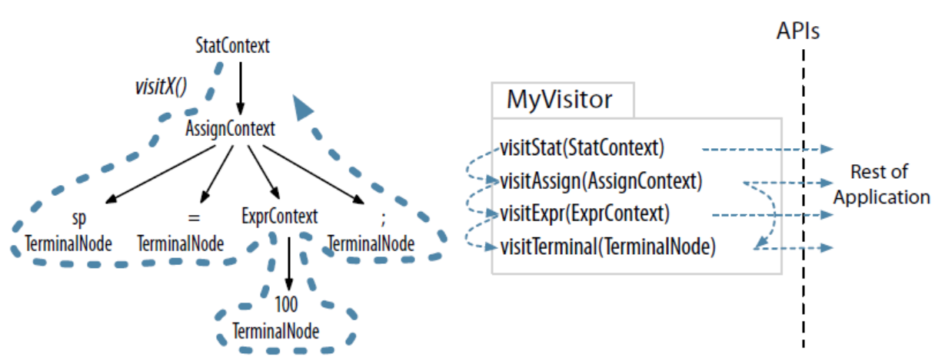
Parse tree Listeners
The thick dashed line shows a depth-first walk of the parse tree.
The thin dashed lines indicate the method call sequence among the visitor methods.

Slide 145


